Slide 1
Dynamic Programming Part 1
CS240 Spring 2023
Rui Fan

Slide 2
Algorithmic paradigms
Greedy Build up a solution incrementally, myopically optimizing some local criterion.
Divide and conquer Break up a problem into a few sub-problems, solve each sub-problem independently and recursively, and combine solution to sub-problems to form solution to original problem.
Dynamic programming Break up a problem into a series of overlapping sub-problems, and build up solutions to larger and larger sub-problems.
Very powerful and widely used technique in CS, OR, info and control theory.
Efficiently solves problems that otherwise seem intractable.
Name comes from dynamic “schedule” of subproblems the algorithm produces.

Slide 3
Algorithmic paradigms
Divide and conquer
Dynamic programming

Slide 4
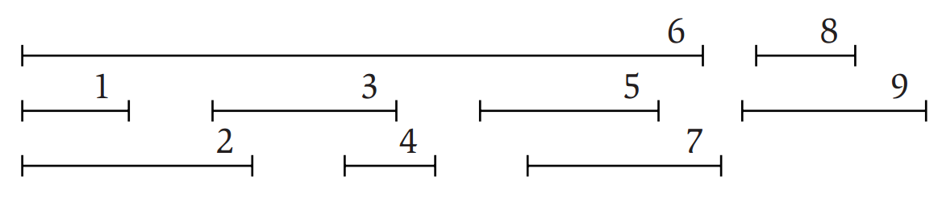
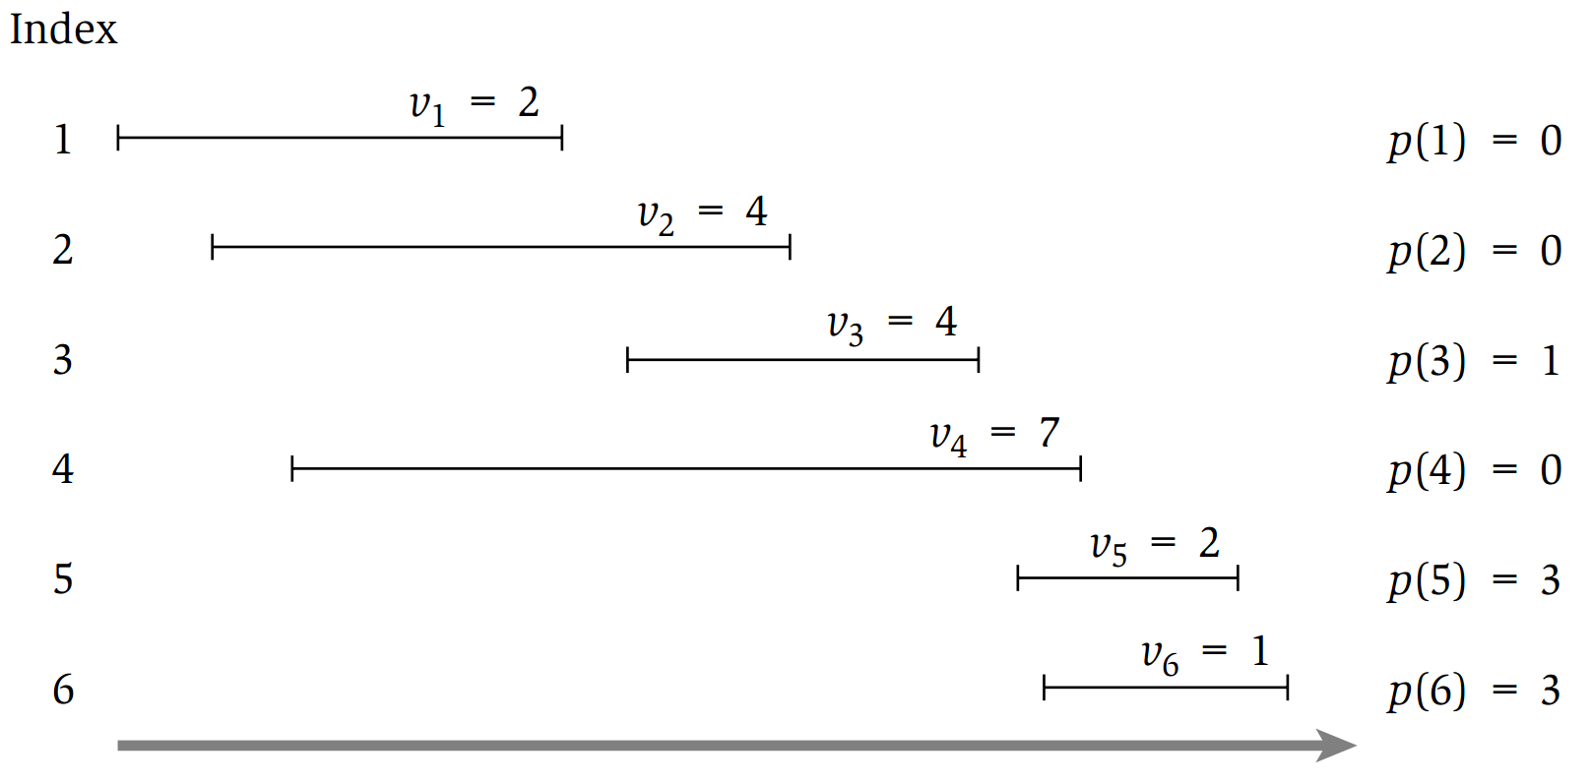
Weighted interval scheduling
Recall the interval scheduling problem
Given a set of intervals, pick the largest set of nonoverlapping intervals.
For n intervals, solvable by a greedy algorithm in O(n log n) time.
Weighted interval scheduling generalizes the problem so the intervals have weights.
Pick a set of nonoverlapping intervals with the largest combined weight.
No known natural greedy algorithm to solve this.
Source: Algorithm Design.
Kleinberg, Tardos

Slide 5
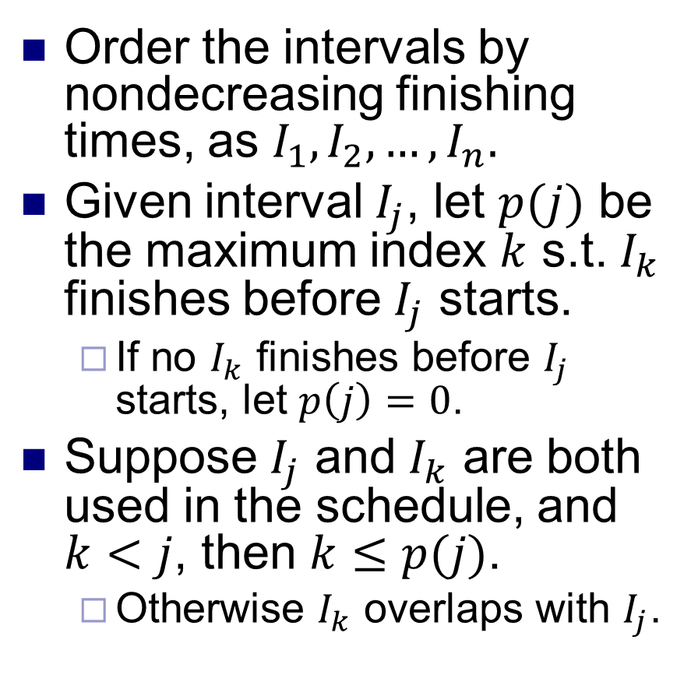
Compatible intervals
Order the intervals by nondecreasing finishing times, as $I_{1},I_{2},…, I_{n}.$
Given interval $I_{j}$, let $p(j)$ be the maximum index $k$ s.t. $I_{k}$ finishes before $I_{j}$ starts.
If no $I_{k}$ finishes before $I_{j}$ starts, let $p\left(j\right)=0$.
Suppose $I_{j}$ and $I_{k}$ are both used in the schedule, and $k<j$, then $k≤p(j)$.
Otherwise $I_{k}$ overlaps with $I_{j}$.

Slide 6
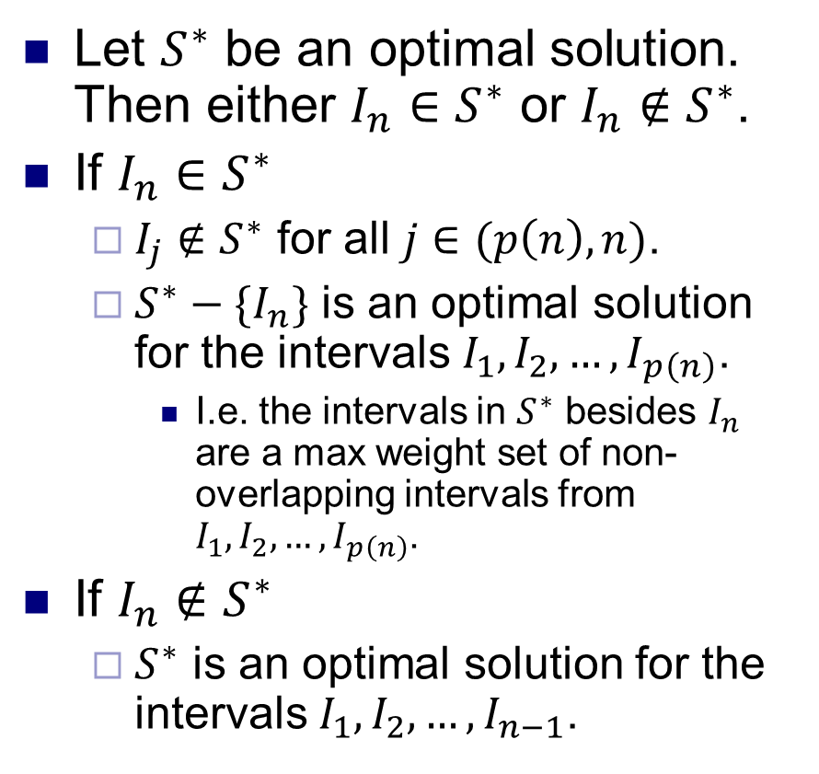
A recursive solution
Let $S^{∗}$ be an optimal solution. Then either $I_{n}∈S^{∗}$ or $I_{n}∉S^{∗}$.
If $I_{n}∈S^{∗}$
$I_{j}∉S^{∗}$ for all $j∈(p\left(n\right), n)$.
$S^{∗}−{\{I}_{n}\}$ is an optimal solution for the intervals $I_{1}, I_{2},…, I_{p\left(n\right)}$.
I.e. the intervals in $S^{∗}$ besides $I_{n}$ are a max weight set of non-overlapping intervals from $I_{1}, I_{2},…, I_{p\left(n\right)}$.
If $I_{n}∉S^{∗}$
$S^{∗}$ is an optimal solution for the intervals $I_{1}, I_{2},…, I_{n−1}$.

Slide 7
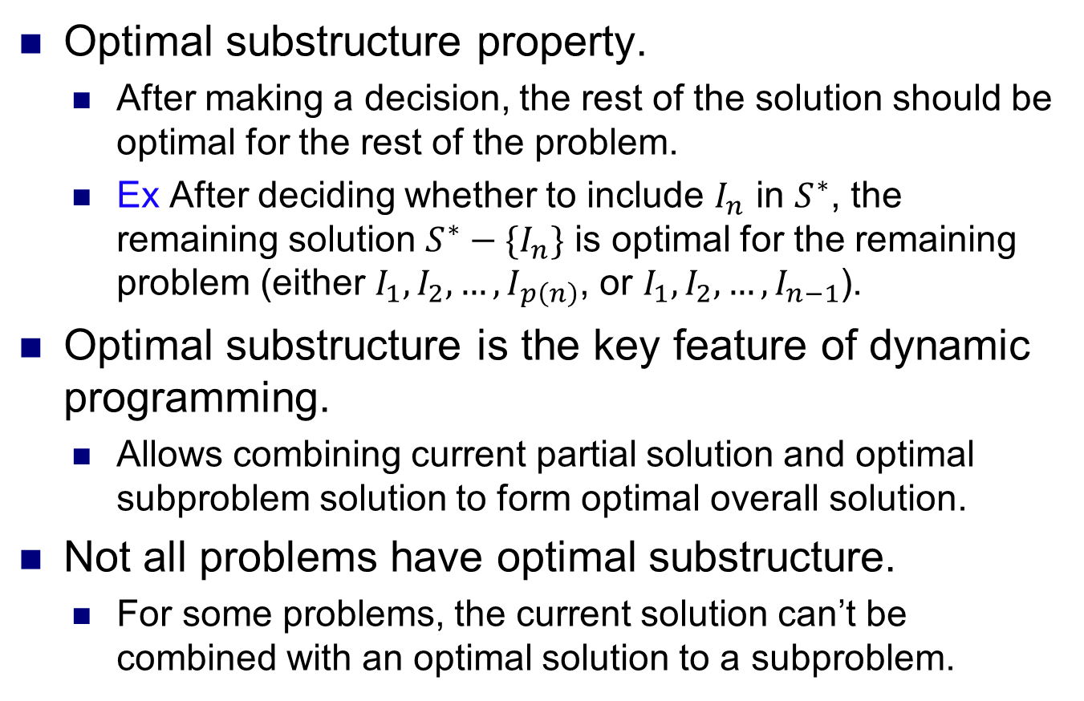
Optimal substructure
Optimal substructure property.
After making a decision, the rest of the solution should be optimal for the rest of the problem.
Ex After deciding whether to include $I_{n}$ in $S^{∗}$, the remaining solution $S^{∗}−\{I_{n}\}$ is optimal for the remaining problem (either $I_{1}, I_{2},…, I_{p\left(n\right)}$, or $I_{1}, I_{2},…, I_{n−1}$).
Optimal substructure is the key feature of dynamic programming.
Allows combining current partial solution and optimal subproblem solution to form optimal overall solution.
Not all problems have optimal substructure.
For some problems, the current solution can’t be combined with an optimal solution to a subproblem.

Slide 8
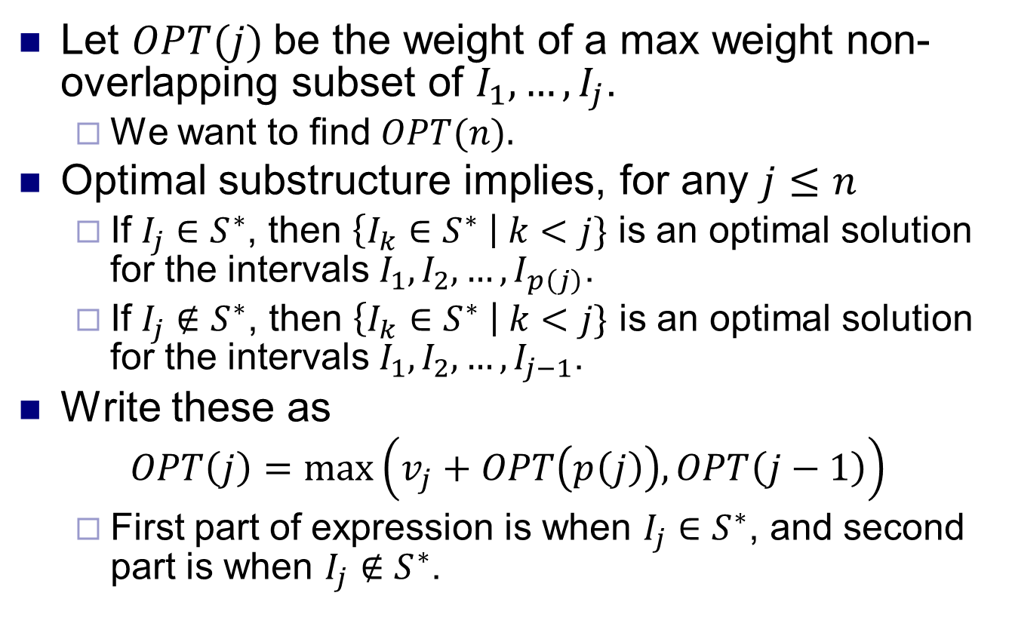
A recursive solution
Let $OPT(j)$be the weight of a max weight non-overlapping subset of $I_{1},…, I_{j}$.
We want to find $OPT(n).$
Optimal substructure implies, for any $j≤n$
If $I_{j}∈S^{∗}$, then $\left\{I_{k}∈S^{∗} \right| k<j\}$ is an optimal solution for the intervals $I_{1}, I_{2},…, I_{p\left(j\right)}$.
If $I_{j}∉S^{∗}$, then $\left\{I_{k}∈S^{∗} \right| k<j\}$ is an optimal solution for the intervals $I_{1}, I_{2},…, I_{j−1}$.
Write these as
$$OPT\left(j\right)=\max\left(v_{j}+OPT\left(p\left(j\right)\right), OPT\left(j−1\right)\right)$$
First part of expression is when $I_{j}∈S^{∗}$, and second part is when $I_{j}∉S^{∗}$.

Slide 9
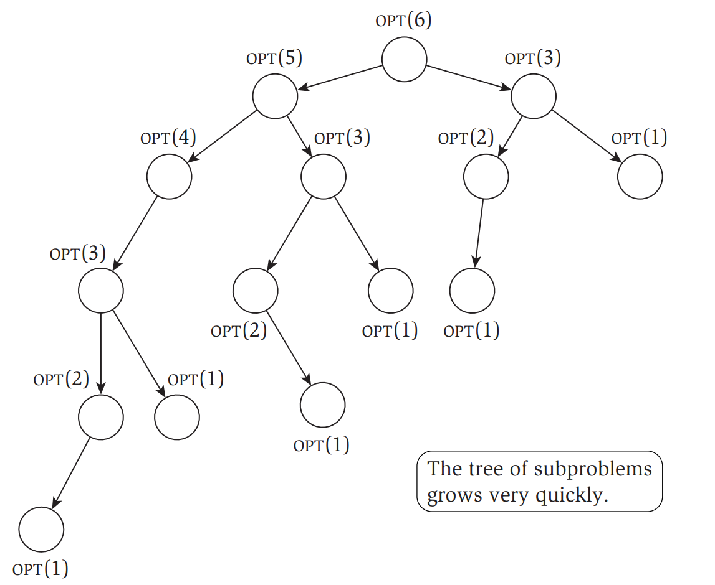
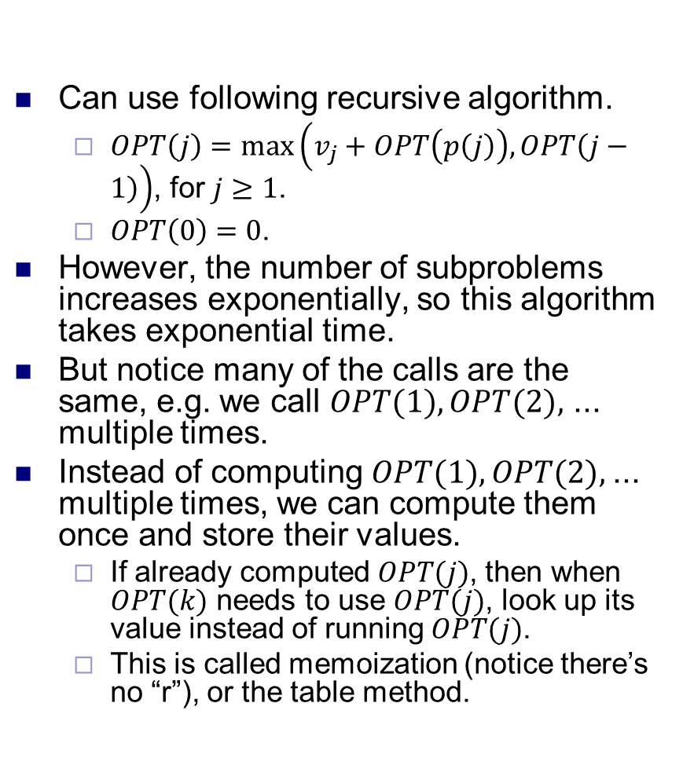
A recursive solution
Can use following recursive algorithm.
$OPT\left(j\right)=\max\left(v_{j}+OPT\left(p\left(j\right)\right), OPT\left(j−1\right)\right)$, for $j≥1$.
$OPT\left(0\right)=0$.
However, the number of subproblems increases exponentially, so this algorithm takes exponential time.
But notice many of the calls are the same, e.g. we call $OPT(1), OPT(2),$ ... multiple times.
Instead of computing $OPT(1), OPT(2),$... multiple times, we can compute them once and store their values.
If already computed $OPT(j)$, then when $OPT(k)$ needs to use $OPT(j)$, look up its value instead of running $OPT(j)$.
This is called memoization (notice there’s no “r”), or the table method.

Slide 10
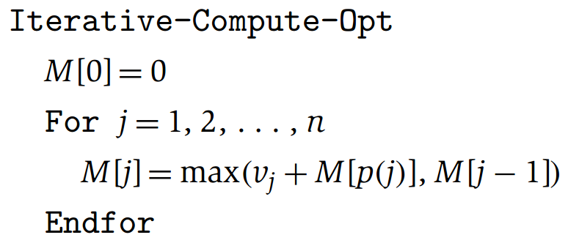
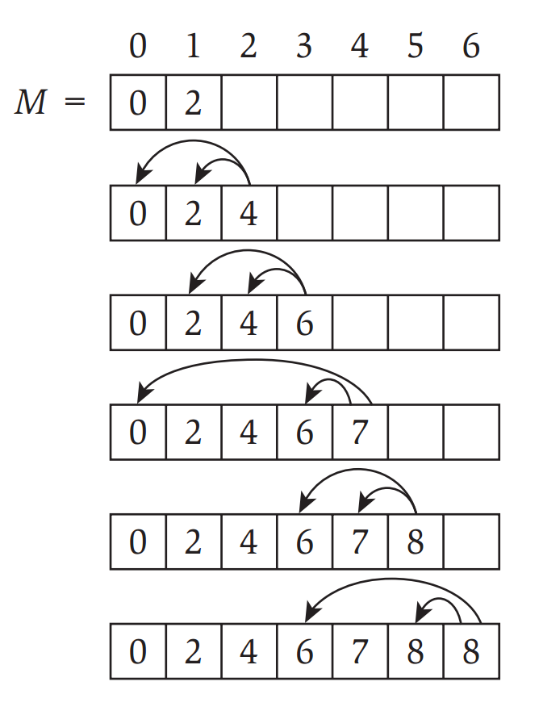
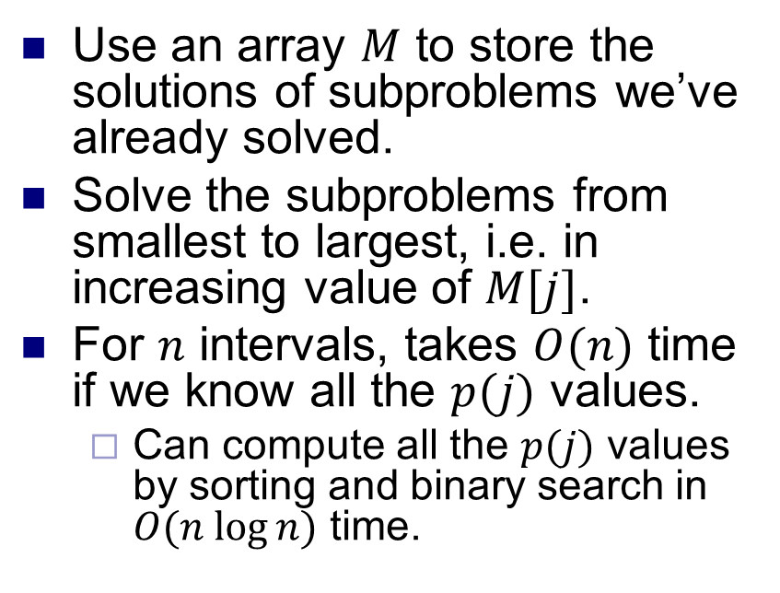
An iterative solution
Use an array $M$ to store the solutions of subproblems we’ve already solved.
Solve the subproblems from smallest to largest, i.e. in increasing value of $M[j]$.
For $n$ intervals, takes $O(n)$ time if we know all the $p(j)$ values.
Can compute all the $p(j)$ values by sorting and binary search in $O(n log⁡n)$ time.

Slide 11
Segmented Least Squares
Least squares.
Foundational problem in statistic and numerical analysis.
Given n points in the plane: (x₁, y₁), (x₂, y₂) , . . . , (x_{n}, y_{n}).
Find a line y = ax + b that minimizes the sum of the squared error:
Solution. Calculus ⇒ min error is achieved when
y
x
Notes:
the term "regression" stems from the work of Sir Francis Galton (1822-1911), a famous geneticist, who studied the heights of fathers and their sons. He found that offspring of a parent of larger than average height tended to be smaller than their parents, and offspring of parents of smaller than average size tended to be larger than their parents. "regression toward mediocrity".
Gauss (1809-1811) used Gaussian elimination to solve multiple linear regression
Gauss-Markov theorem (least squares estimates are uniformly minimum variance estimates (UMVUE) among all linear unbiased estimates)

Slide 12
Segmented Least Squares
Segmented least squares.
Points lie roughly on a sequence of several line segments.
Given n points in the plane (x₁, y₁), (x₂, y₂) , . . . , (x_{n}, y_{n}) with x₁ < x₂ < ... < x_{n}, find a sequence of lines that minimizes a cost function
Q. What's a reasonable choice for the cost function?
Shall balance accuracy and parsimony
goodness of fit
number of lines
y
x

Slide 13
Segmented Least Squares
Segmented least squares.
Points lie roughly on a sequence of several line segments.
Given n points in the plane (x₁, y₁), (x₂, y₂) , . . . , (x_{n}, y_{n}) with x₁ < x₂ < ... < x_{n}, find a sequence of lines that minimizes E + c L
E: the sum of the sums of the squared errors in each segment
L: the number of lines
c: some positive constant
y
x
Notes:
In class: ask students to give a DP solution

Slide 14
Dynamic Programming: Multiway Choice
Notation.
OPT(j) = minimum cost for points p₁, p_{i+1} , . . . , p_{j}.
e(i, j) = minimum sum of squares for points p_{i}, p_{i+1} , . . . , p_{j}.
To compute OPT(j):
If: last segment uses points p_{i}, p_{i+1} , . . . , p_{j} for some i.
Then: cost = e(i, j) + c + OPT(i-1).

Slide 15
Segmented Least Squares: Algorithm
Running time. O(n³).
Bottleneck = computing e(i, j) for O(n²) pairs, O(n) per pair using previous formula.
INPUT: n, p₁,…,p_{N ,} c
Segmented-Least-Squares() {
for j = 1 to n
for i = 1 to j
compute the least square error e(i,j) for the
segment p_{i},…, p_{j}
M[0] = 0
for j = 1 to n
M[j] = min _{1 ≤ i ≤ j} (e(i,j) + c + M[i-1])
return M[n]
}
Notes:
Book: can be improved to O(n²) by pre-computing various statistics. How???

Slide 16
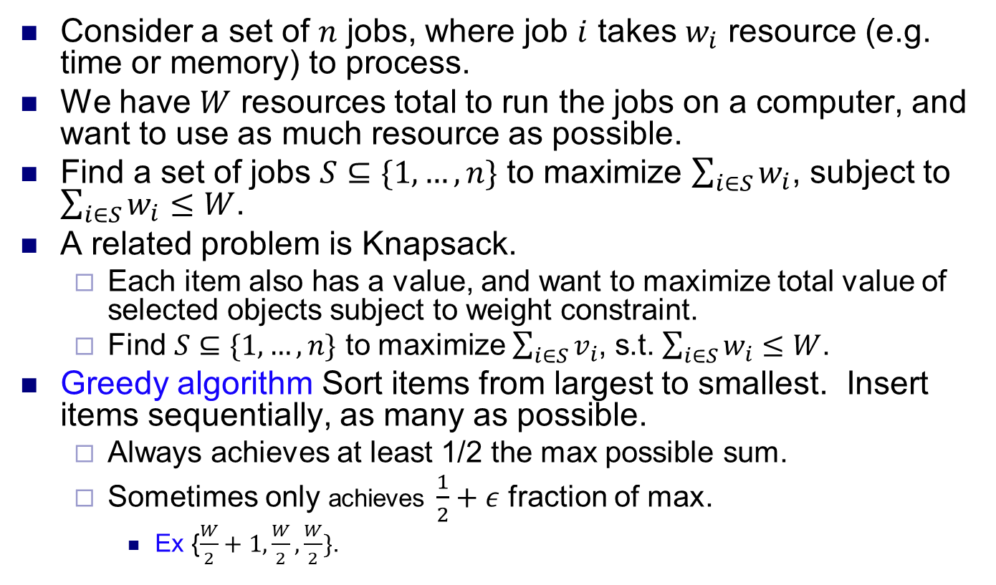
Subset Sum
Consider a set of $n$ jobs, where job $i$ takes $w_{i}$ resource (e.g. time or memory) to process.
We have $W$ resources total to run the jobs on a computer, and want to use as much resource as possible.
Find a set of jobs $S⊆\{1, …, n\}$ to maximize $\sum_{i∈S}{w_{i}}$, subject to $\sum_{i∈S}{w_{i}≤W}$.
A related problem is Knapsack.
Each item also has a value, and want to maximize total value of selected objects subject to weight constraint.
Find $S⊆\{1, …, n\}$ to maximize $\sum_{i∈S}{v_{i}}$, s.t. $\sum_{i∈S}{w_{i}≤W}$.
Greedy algorithm Sort items from largest to smallest. Insert items sequentially, as many as possible.
Always achieves at least 1/2 the max possible sum.
Sometimes only achieves $\frac{1}{2}+ε$ fraction of max.
Ex {$\frac{W}{2}+1,\frac{W}{2},\frac{W}{2}\}$.

Slide 17
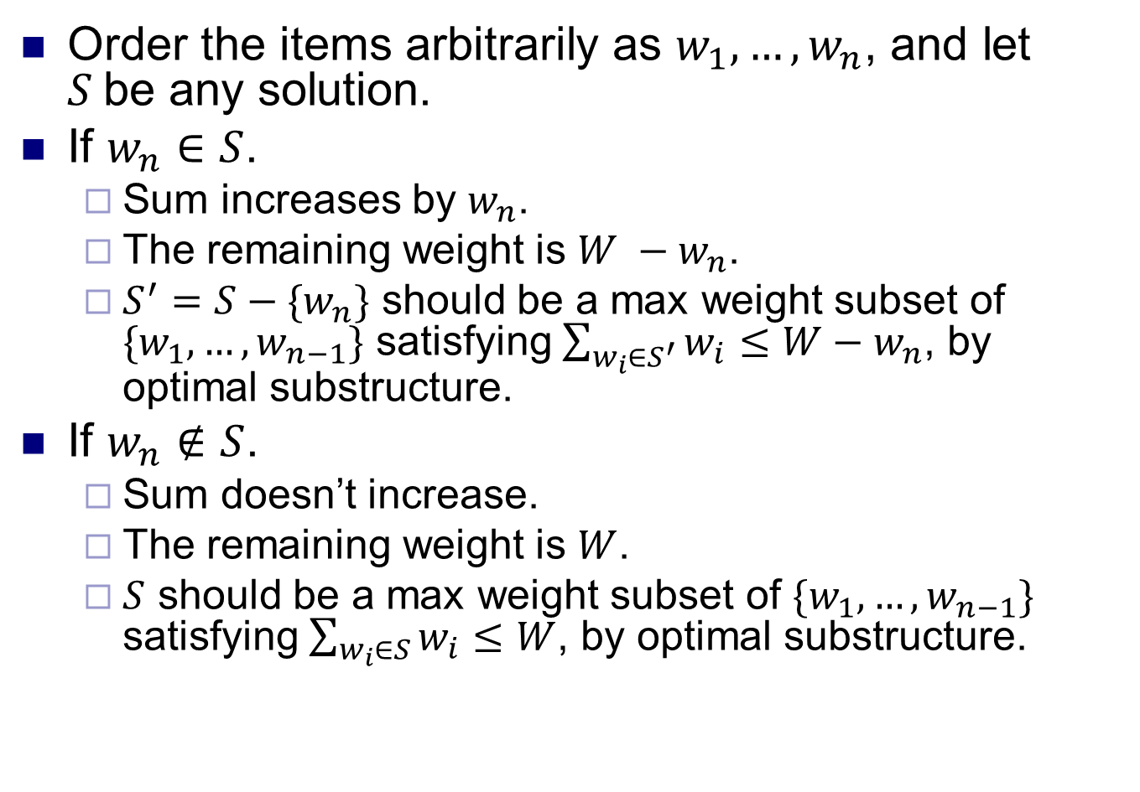
Optimal substructure
Order the items arbitrarily as $w_{1},…, w_{n}$, and let $S$be any solution.
If $w_{n}∈S$.
Sum increases by $w_{n}$.
The remaining weight is $W −w_{n}$.
$S^{′}=S−\{w_{n}\}$ should be a max weight subset of $\{w_{1},…, w_{n−1}\}$ satisfying $\sum_{w_{i}∈S^{′}}{w_{i}}≤W−w_{n}$, by optimal substructure.
If $w_{n}∉S$.
Sum doesn’t increase.
The remaining weight is $W$.
$S$ should be a max weight subset of $\{w_{1},…, w_{n−1}\}$ satisfying $\sum_{w_{i}∈S}{w_{i}}≤W$, by optimal substructure.

Slide 18
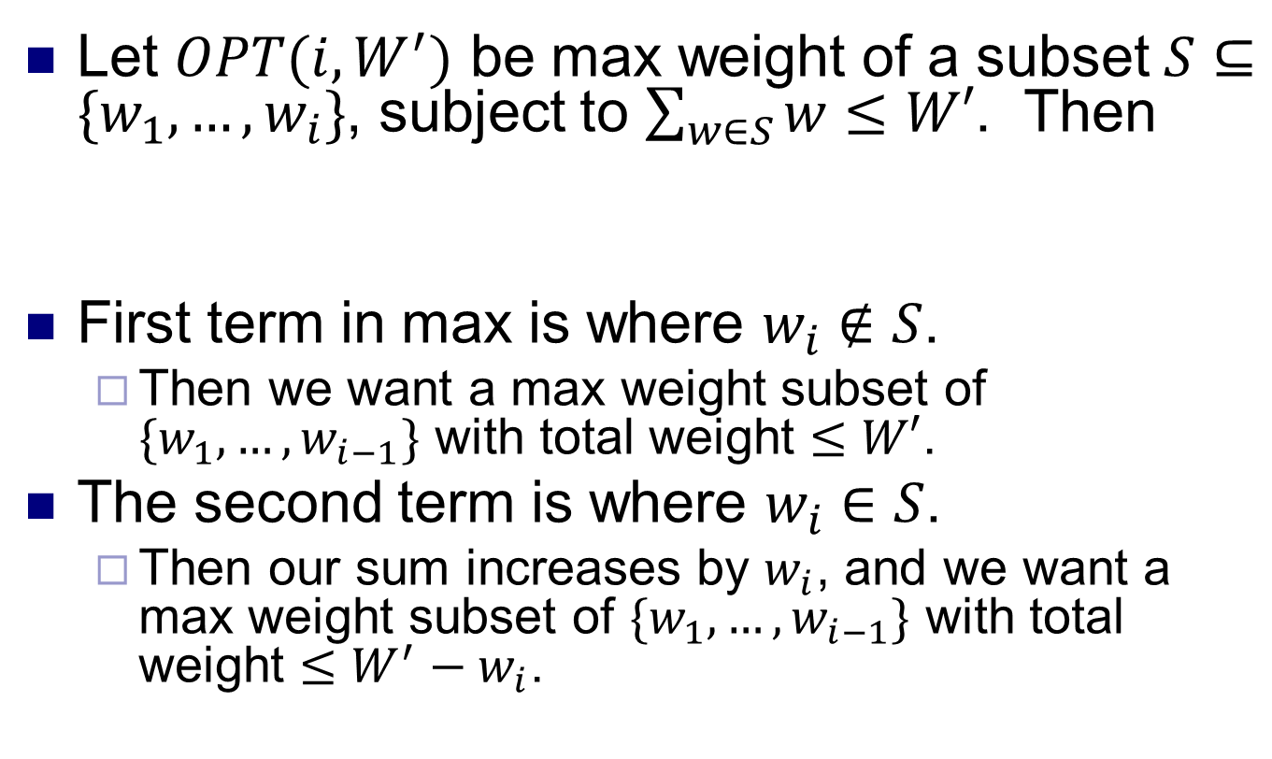
Dynamic programming solution
Let $OPT(i,W^{′})$ be max weight of a subset $S⊆\{w_{1},…,w_{i}\}$, subject to $\sum_{w∈S}{w}≤W′$. Then
First term in max is where $w_{i}∉S$.
Then we want a max weight subset of $\{w_{1},…,w_{i−1}\}$ with total weight $≤W′$.
The second term is where $w_{i}∈S$.
Then our sum increases by $w_{i}$, and we want a max weight subset of $\{w_{1},…,w_{i−1}\}$ with total weight $≤W^{′}−w_{i}$.
$$OPT\left(i,W^{′}\right)=\max{(OPT(i−1}, W′),w_{i}+OPT(i−1, W^{′}−w_{i}))$$

Slide 19
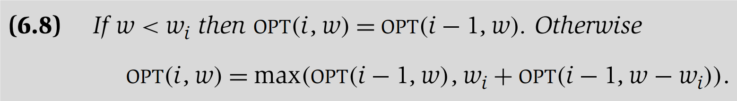
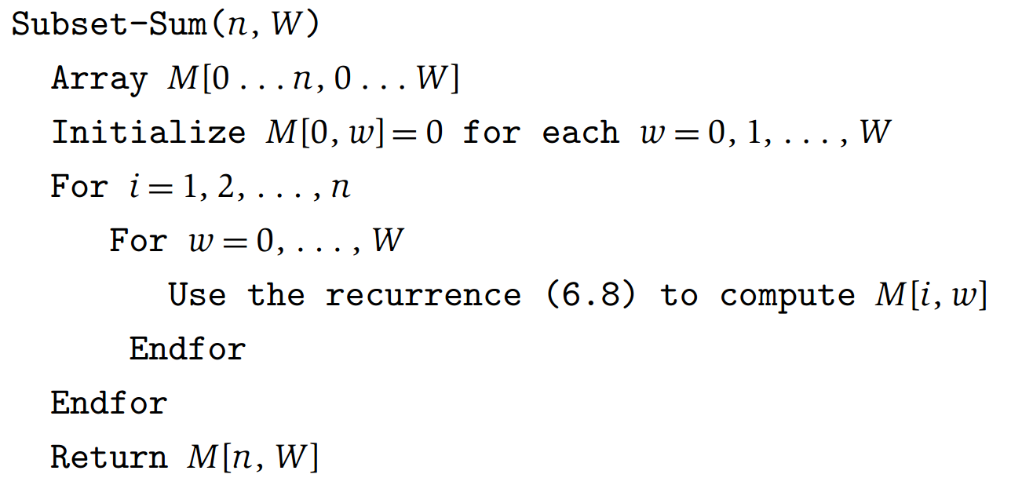
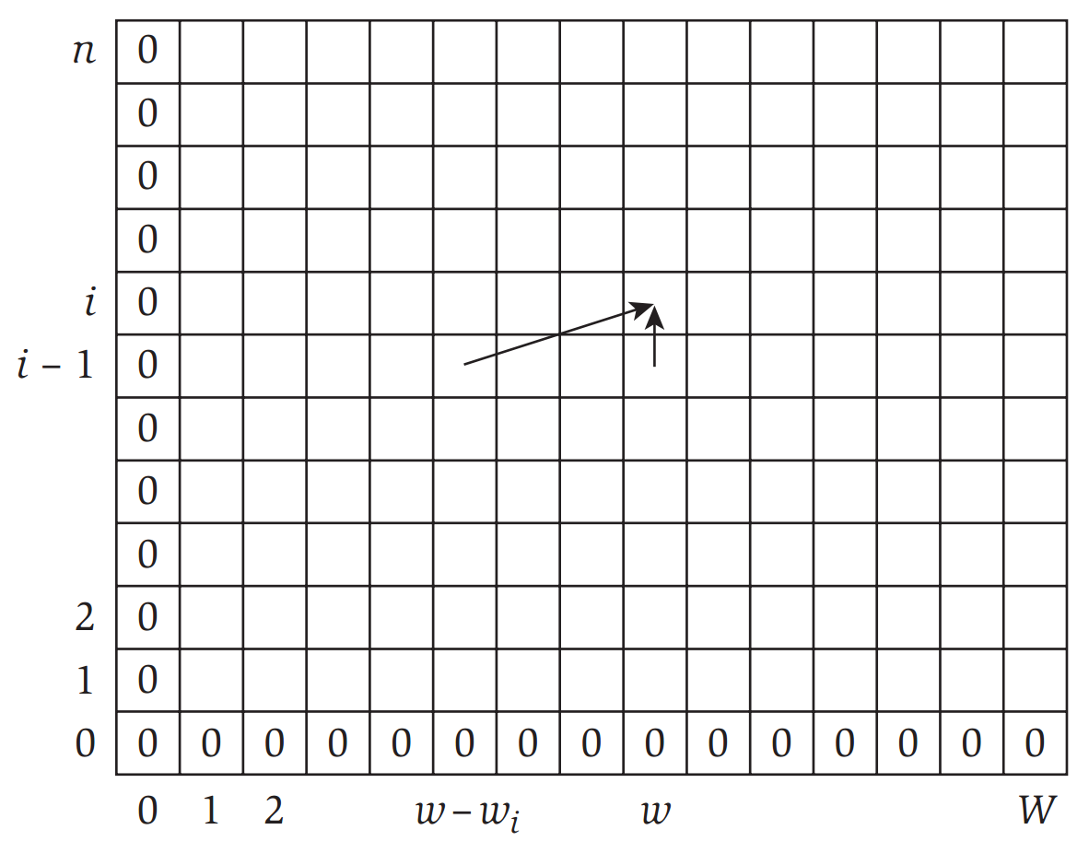
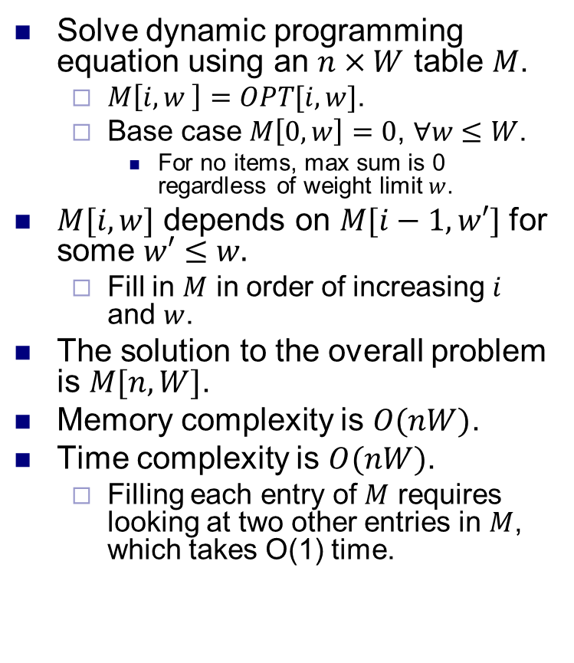
Table method for Subset Sum
Solve dynamic programming equation using an $n×W$ table $M$.
$M\left[i,w \right]=OPT[i,w]$.
Base case $M\left[0,w\right]=0$, $∀w≤W$.
For no items, max sum is 0 regardless of weight limit $w$.
$M[i,w]$ depends on $M[i−1, w′]$ for some $w′≤w.$
Fill in $M$ in order of increasing $i$ and $w$.
The solution to the overall problem is $M[n,W]$.
Memory complexity is $O(nW)$.
Time complexity is $O(nW)$.
Filling each entry of $M$ requires looking at two other entries in $M$, which takes O(1) time.

